Slide 1
30th ANNNUAL CONFERENCE (1992-2022) 13th - 14th May 2022, BMA House, London
VIOLENCE AS A PUBLIC HEALTH EMERGENCY:
PREVENTING, TREATING AND HUMANIZING THE DANGEROUS MIND
EXPLORING THE PAST, PRESENT AND FUTURE OF FORENSIC PSYCHOTHERAPY
Follow us on Twitter @IAFP2021

Slide 2
FRIDAY 13th MAY 2022 - MORNING
8.15am | Start | Registrations & Coffees
8.45am | Opening PAGET ROOM | Welcome & Introduction Dr Estela Welldon, Dr Carine Minne
9.00am | PLENARY 1 PAGET ROOM Chair: Carine Minne | Professor Brett Kahr (UK) “Let the Great Axe Fall”: From Ancient Babylonian Torture to Modern Forensic Psychotherapy. Freud, Welldon, and the Humanization of Criminality” Professor Timothy Keogh (Australia) “Bringing our light out from under the bushel: The unrealised potential of forensic psychotherapy”
11 – 11.30am | Coffee Break
11.30am | PLENARY 2 PAGET ROOM Chair: Estela Welldon | Dr Moises Lemlij (Peru) “Politics and Violence” Dr James Gilligan (USA) “What is Forensic Psychotherapy, and Why Is It So Important?”
1 – 1.45pm | Lunch SNOW ROOM

Slide 3
FRIDAY 13th MAY 2022 - AFTERNOON
13.45 | PARALLEL SESSIONS
1. | LISTER FLEMING ROOM Chair: Estela Welldon | 1A: Stephen Blumenthal: A State of Inbetweeness: The Challenges of Working with Disavowal 1B: Elena Mundici: A matter of wife and death. Reflections on music and violence JOIN HERE
2. | BLACK ROOM Chair: Cleo Van Velsen | 2A: Natalie Parrett, Kate Marsh, Vikki Wakefield: Social Responsibility Units (SRU): A Serco custodial initiative designed to address institutional violence and anti-social behaviour 2B: Leslie Lothstein, Kathryn Thomas: Adam Lanza and Sandy Hook: Trying to Humanize the Dangerous Mind during a time when Lethal Military Weaponry are available at will in the USA. JOIN HERE
3. | HARVEY ROOM Chair: TBC | 3A: David Millar: Contorting the Psyche: Thinking Non-Violently in a Violent World 3B: Deborah Jump, David Gray: Partners in crime: the role of forensic psychotherapy in criminological thinking JOIN HERE
4. | SIMPSON ROOM Chair: Richard Curen | 4A: Raffaella Hilty: The Eroticisation of the Gaze in the Psychoanalytic Treatment of a Paedophile 4B: Marianna Caserio: Violence and feminism: a philosophical approach JOIN HERE
5. | JENNER ROOM Chair: Lorna Downing | Celia Taylor, Stella Compton-Dickinson, Alex Maguire: Where words fail: the role of music therapy in modifying the aggressive impulse. JOIN HERE

Slide 4
FRIDAY 13th MAY 2022 - AFTERNOON
15.15 | Coffee Break (SNOW ROOM)
15.45 (UK) | PLENARY 3 PAGET ROOM Chair: Prof Nicola Lacey | Dr Carine Minne & Dr Ronnie Doctor - IPA slot (UK) “Violence, Psychoanalysis, the Law and the Superego” Introduction: Dr Harriet Wolfe, IPA President
17.00 | Coffee break (SNOW ROOM)
17.30 (UK) | Large Group PAGET ROOM | Moderator: Dr Earl Hopper

Slide 5
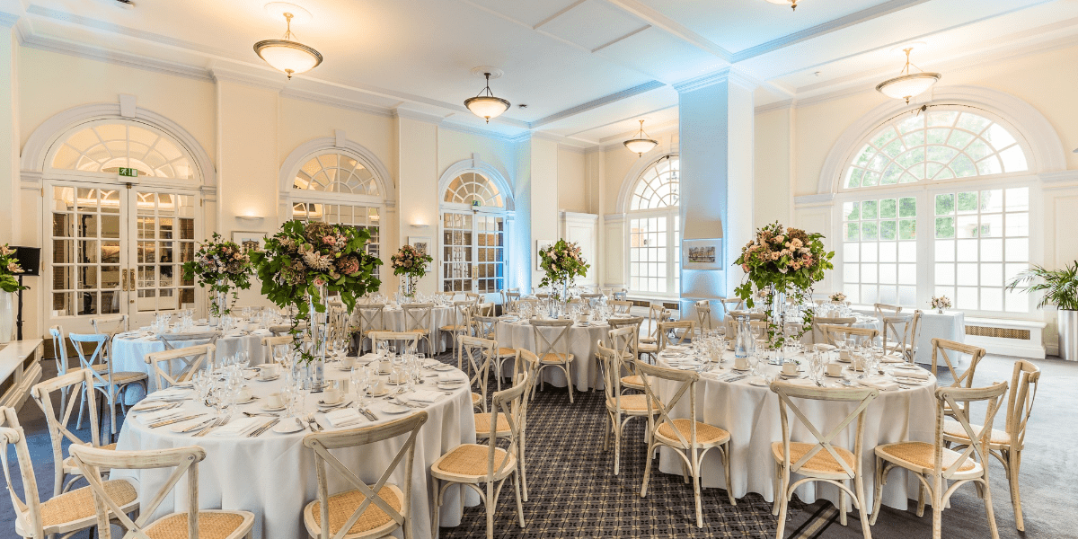
FRIDAY 13th MAY 2022 – EVENING 7.30-9 PM GALA BANQUET DINNER

Slide 6
SATURDAY 14th MAY 2022 - MORNING
8.30am | Start | Registrations & Coffees
9.00am | PLENARY 4 PAGET ROOM Chair: Colin Campbell | Dr Anne Aiyegbusi (UK) “Big, Black and Dangerous” Discussant: Dr Abdullah Mia
10am | PLENARY 5 PAGET ROOM Chair: Ronald Doctor | Prof. Gwen Adshead, Dr Amy Hamilton, Dr Bradley Hillier “Introducing a homicide offender rehabilitation programme to medium secure services? High time!”
11am | Coffee Break (SNOW ROOM)
11.30am | PLENARY 6 PAGET ROOM Chair: Massimo De Mari | Konstantin Nemirovsky (Russia) “The root of evil: Why ordinary people lose their humanity in unordinary circumstances” Natalia Frolova (Russia) “Odd one in: A psychotherapist’s experience of interaction with the judicial system in working with patients with high levels of destructiveness”
1 – 2pm | Lunch SNOW ROOM
1.30 – 2.30pm | Annual General Meeting (AGM) IAFP Board Election

Slide 7
SATURDAY 14th MAY 2022 - AFTERNOON
14.30 | PARALLEL SESSIONS
1. | LISTER FLEMING ROOM Chair: David Millar | 1A: John Young: Violence vs. Compassion: Pursuing the Pandemic 1B: Christian Eigner: The overlooked phenomenon of "hysterically situated" aggression JOIN HERE
2. | BLACK ROOM Chair: Sandra Grant | 2A: Jim Rymer: Freud, Roupaul, Grason and a whole lot of naked attraction! 2B: Emily Turton: Out of sight out of mind 2C: Manjit Sidhu: Forensic Mental Health Nurses' Experiences of Working with Intimate Partner Violence JOIN HERE
3. | JENNER ROOM Chair: Moustafa Saoud | 3A: Caterina Marchetti, Patrizia De Rosa: The breaking of ties and the triggering of a malignant experience, as a defence from anxiety. 3B: Ross Goslin: Cyber violence: how does it penetrate the body barrier? JOIN HERE
4. | SIMPSON ROOM Chair: Victoria Childs | 4A: Andrew Shepherd (remote): Public response to violence: Trauma and spectacle 4B: Gerard Drennan: Restorative Justice - a social justice framework for responding to dangerous states of mind? JOIN HERE
5. | HARVEY ROOM Chair: Pamela Windham-Stewart | 5A: Jessica Collier: "Men just hit you": Internalised misogyny and art psychotherapy with women in prison 5B: Mizuho Koizumi: 'The only patient on the ward.' Communication of distress through violence when there is limited verbal ability, and how this was contained and understood through art psychotherapy. 5C: Aimee Parker: Under the skin intense fire burns: boundaries, exposure and disclosure in an individual art psychotherapy session within an MSU JOIN HERE

Slide 8
SATURDAY 14th MAY 2022 - AFTERNOON
16pm | Coffee Break (SNOW ROOM)
16.30 (UK) | PLENARY 7 PAGET ROOM Chairs: Simon Israel | Lord John Alderdice (UK) “Can a focus on the importance of relationships help us address the pandemic of violence?” Dr Bandy Lee (USA) ”Societal disorder as a precursor to dangerous minds in politics”

Slide 9
SATURDAY 14th MAY 2022 - EVENING
18pm | Coffee break (SNOW ROOM)
18.15-19.15pm (UK) | Large Group PAGET ROOM | Moderator: Dr Earl Hopper
19.15 -21pm | Closing Event SNOW ROOM | Announcement of the Gill McGauley Prize Winners Announcement of the 2023 Turin conference Closing drinks

